Slide 1
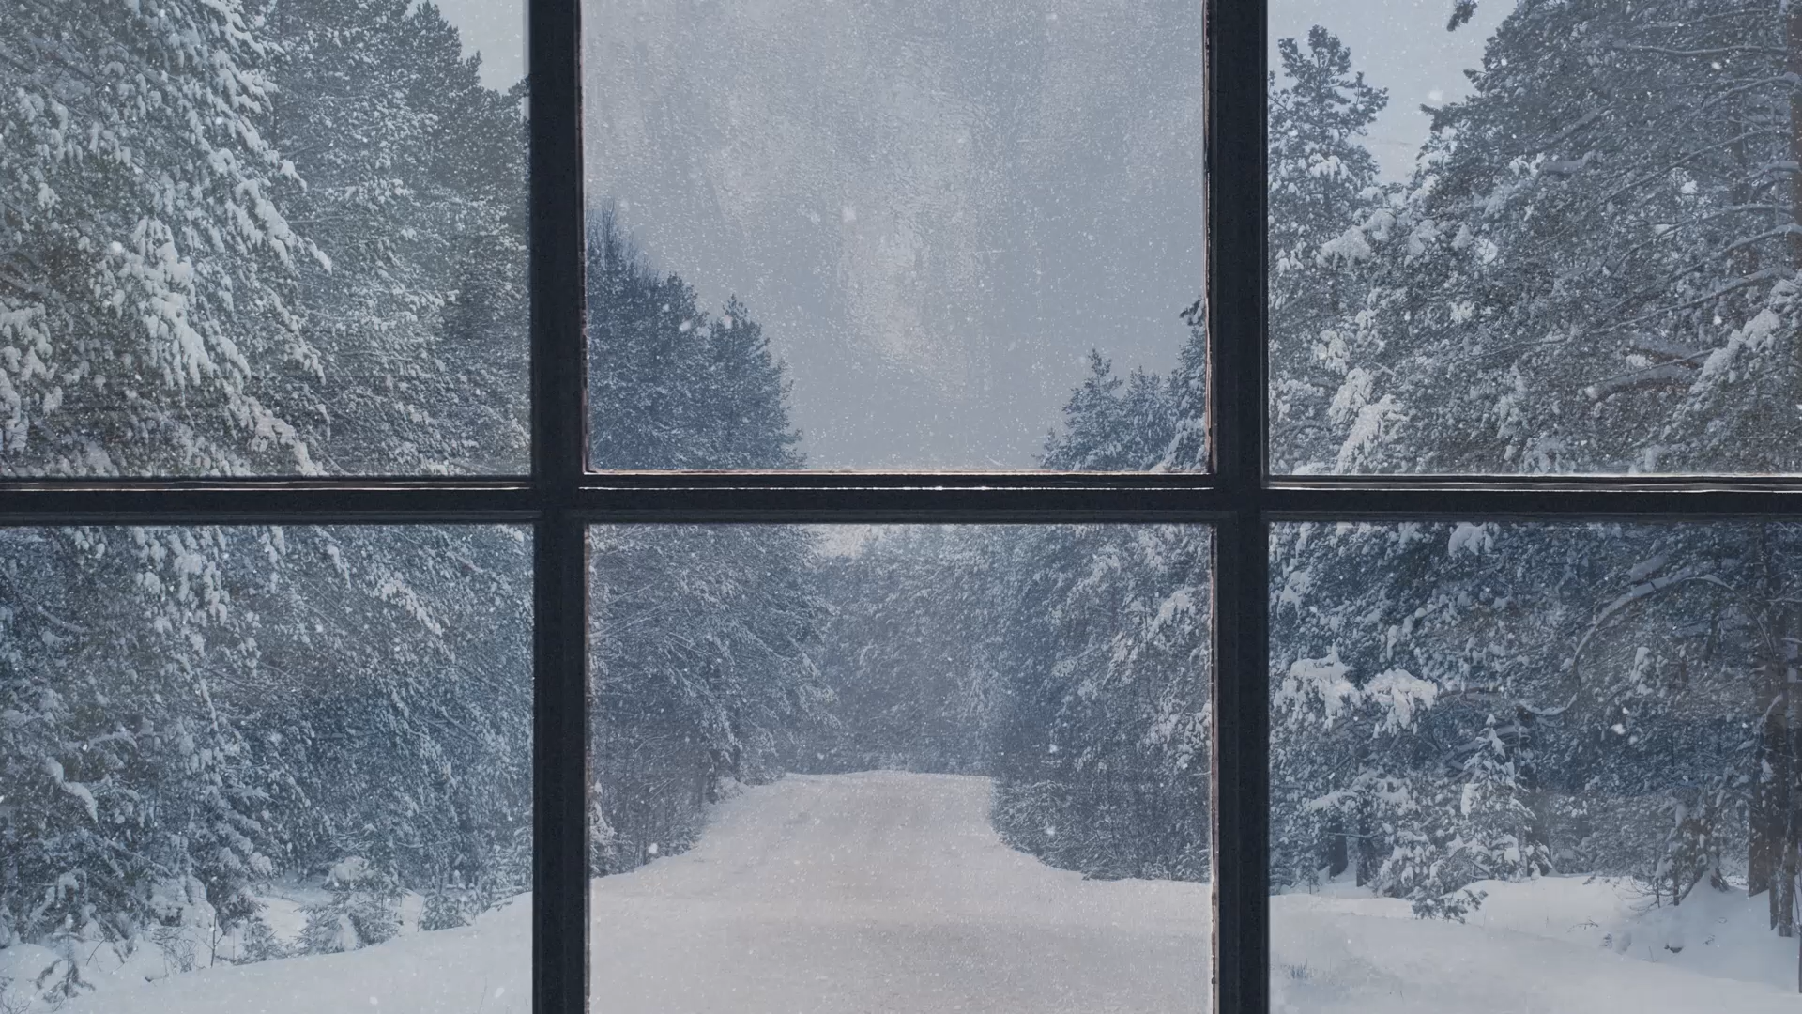
Windows, Mirrors and Doors
Exploring Spirituality

Slide 2
What is Spirituality?
Spirituality helps us think about big questions
It helps us understand ourselves and the world around us
It's about wondering, thinking deeply, and growing as a person

Slide 3
Three Ways to Explore
Windows 🪟
Mirrors 🪞
Doors 🚪

Slide 4
Windows 🪟
What are Windows?
Windows help us look OUT at the world
They help us see God's world in new and amazing ways
They help us notice things we've never seen before
Examples:
Looking at nature and seeing God's creation
Learning about different people and places
Discovering new stories and ideas

Slide 5
Windows Activity Ideas
Watch a beautiful sunset
Look closely at a flower or leaf
Listen to inspiring music
Explore stories from the Bible
Learn about people who help others

Slide 6
Mirrors 🪞
What are Mirrors?
Mirrors help us look INWARD at ourselves
They give us time to think and reflect
They help us ask big questions
Examples:
Who am I?
What do I believe?
How do I feel?
What matters to me?

Slide 7
Mirrors Activity Ideas
Quiet thinking time
Prayer and meditation
Journaling or drawing our thoughts
Asking ourselves: "What have I learned today?"
Thinking about how we can be better people

Slide 8
Doors 🚪
What are Doors?
Doors help us step FORWARD into action
They give us chances to respond to what we've learned
They help us put our beliefs into practice
Examples:
Being kind to someone
Helping in our community
Standing up for what's right
Making a difference in the world

Slide 9
Doors Activity Ideas
Create art or music inspired by what we've learned
Write a prayer or poem
Do something kind for someone else
Start a project to help others
Make a promise to change something about ourselves

Slide 10
Putting It All Together
Windows → We see something new about God's world ↓
Mirrors → We think about what it means for us ↓
Doors → We do something about it!

Slide 11
Example Journey
Window: We learn about people who don't have clean water ↓
Mirror: We think about how lucky we are and how we can help ↓
Door: We raise money for a water charity or save water at home

Slide 12
Remember
Every day we can:
🪟 Open our eyes to see God's world
🪞 Look in the mirror to understand ourselves
🚪 Walk through doors to make a difference

Slide 13
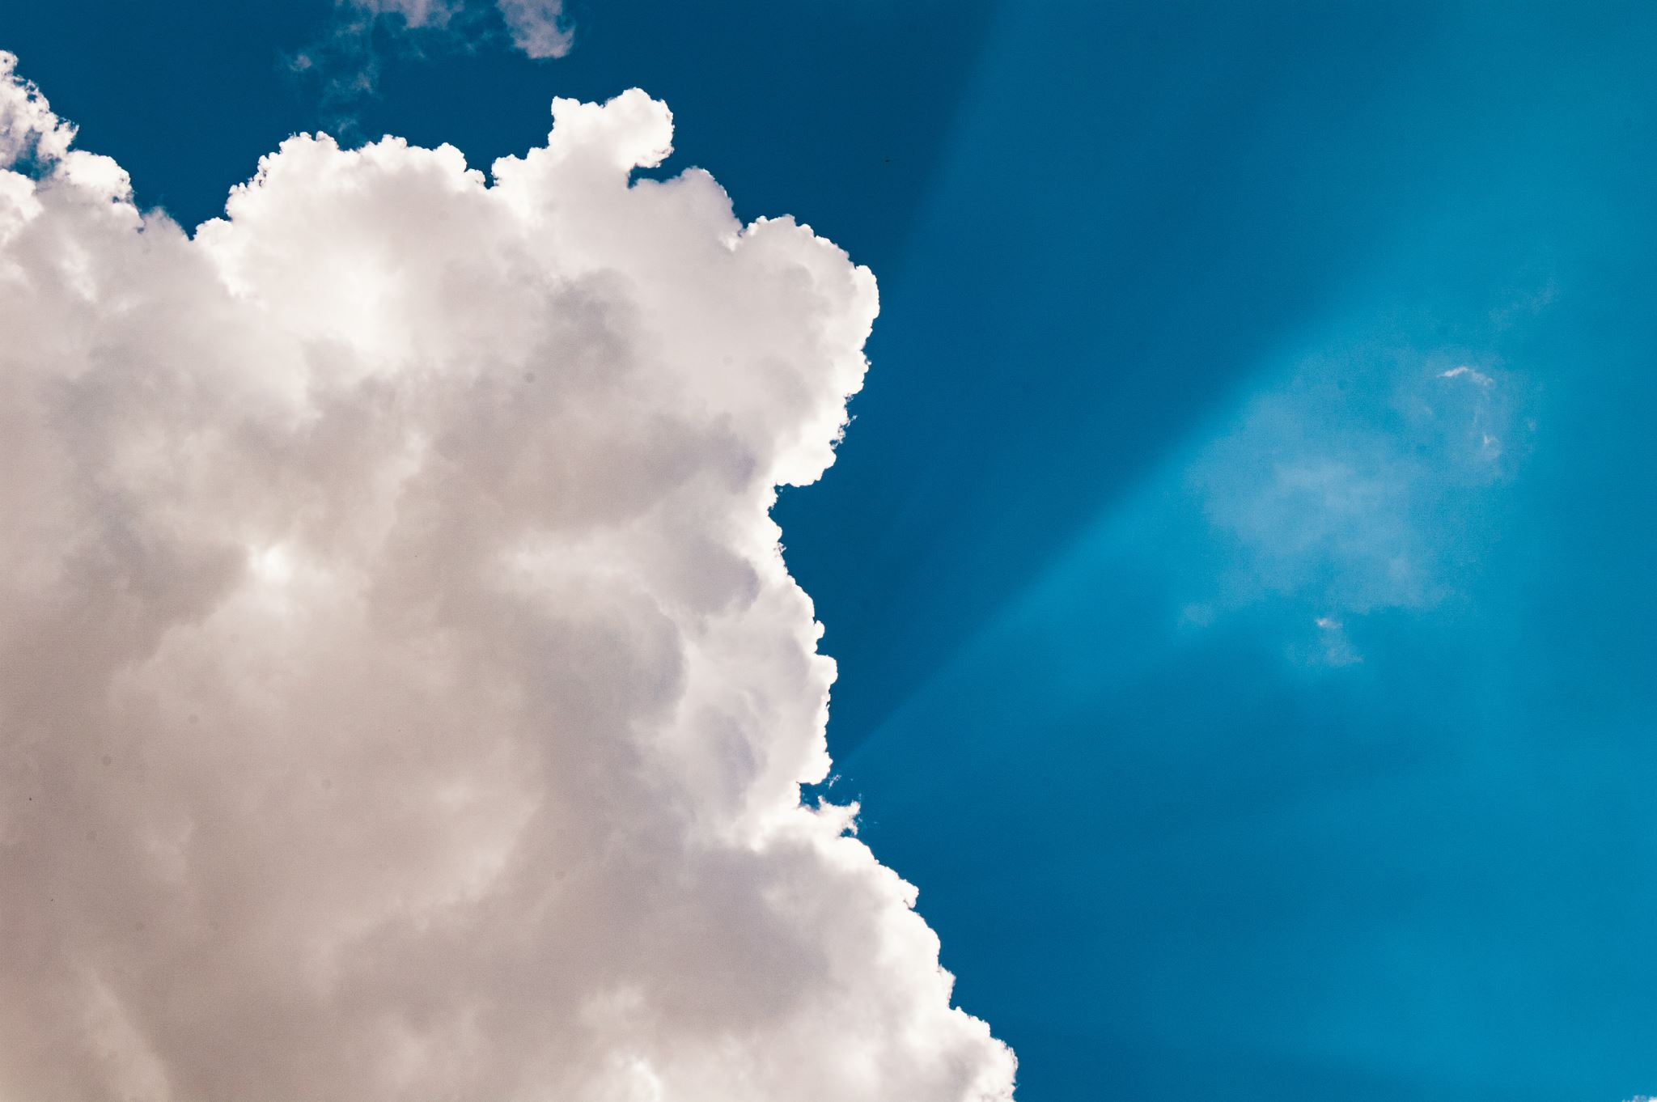
Psalm 19 vs 1-6
The heavens proclaim the glory of God.
The skies display his craftsmanship.
Day after day they continue to speak;
night after night they make him known.
They speak without a sound or word;
their voice is never heard.
Yet their message has gone throughout the earth,
and their words to all the world.
God has made a home in the heavens for the sun.
It bursts forth like a radiant bridegroom after his wedding.
It rejoices like a great athlete eager to run the race.
The sun rises at one end of the heavens
and follows its course to the other end.
Nothing can hide from its heat.

